Slide 1
Learning From Images Coding Project
Atikul Islam Sajib

Slide 2
What is Alzheimer’s Disease?
Alzheimer’s disease is the most common type of dementia
It is a progressive disease begining with mild memory loss and possibly leading to loss of the ability to carry on a conversation and respond to the environment
It involves the part of the brain that control thought memory and language
It can seriously affect person’s ability to carry out daily activities

Slide 3
Why it is important?
In 2020, as many as 5.8 million Americans were living with Alzheimer’s disease
Younger people may get Alzheimer’s disease, but it is less common
The number of people living with the disease doubles every 5 years beyond age 65
This number is projected to nearly triple to 14 million people by 2060
Symptoms of the disease can first appear after age 16 and the risk increases with age

Slide 4
State-of-the-art Approaches
Deep Learning is a sub field of Artifical Intelligence (AI) uses various probabilistic and optimization techniques to help computers learn from huge and complicated data set.
This work will concentrate on the early prediction of Alzheimer’s disease with deep neural network methods and the accuracy achieved is 98% on test and validation data set

Slide 5
Features
Utilizes PyTorch for implementing Alzheimer model.
Provides scripts for easy training and testing images.
Command Line Interface for easy interaction.
Includes a custom data loader for the custom medical image dataset.

Slide 6
Dataset
The dataset downloaded from Kaggle and it contains:
Control Demented (1250 Files)
PD Demented (1250 Files)
AD Demented (800 Files)

Slide 7
List the Main Result on Train Data
Evaluation Matrix | Scores
Accuracy | .975
Precision | .976
Recall | .976
F1 Score | .976

Slide 8
List the Main Result on Test Data
Evaluation Matrix | Scores with K Fold CV-5
Accuracy | .982
Precision | .985
Recall | .982
F1 Score | .981

Slide 9
Command Line Operations
Cloning Repository:
Command: !git clone https://github.com/atikul-islam-sajib/GoodPractiseDSID.git
Setting Working Directory:
Command: %cd /content/GoodPractiseDSID
Python Version:
Python 3.9 or higher.
Execution Requirements:
pip install -r requirements.txt.
Hardware Requirement:
Access to GPU/MPS resources is recommended for efficient model training and evaluation.

Slide 10
CLI Option
Option | Description
--dataset <path> | Specifies the path to the dataset.
--batch_size <size> | Sets the batch size for training the model.
--model | Indicates that a model parameter is expected.
--epochs <number> | Defines the number of training cycles through the entire dataset.
--lr <rate> | Sets the learning rate for the optimizer
--device <device> | Define CPU and GPU
--augmentation <number> | Define the augmentation samples
--get_all_metrics | This might include accuracy, precision, recall, F1 score, etc.
--get_all_charts | Training process, performance metrics, or other relevant data.

Slide 11
CLI Training
Step | Command
Training the Classifier | !python alzheimer/classifier/classifier.py --dataset /content/dataset.zip --batch_size 64 --model --epochs 500 --lr 0.001 --device gpu
Training the Classifier with augmentation samples | !python alzheimer/classifier/classifier.py --dataset /content/dataset.zip --augmentation 1000 --batch_size 64 --model --epochs 500 --lr 0.001 --device gpu
Generating Metrics | !python alzheimer/classifier/classifier.py --get_all_metrics --device gpu
Creating Charts | !python alzheimer/classifier/classifier.py --get_all_charts

Slide 12
Implementation Steps: Importing modules
Importing Modules for Alzheimer's Analysis:
from alzheimer.data.data_loader import Dataloader
from alzheimer.features.build_features import FeatureBuilder
from alzheimer.models.train_model import Trainer
from alzheimer.models.model import Classifier
from alzheimer.visualization.visualize import ChartManager
Unzipping the Dataset:
loader = Dataloader(zip_file='/content/dataset.zip')
loader.unzip_dataset()

Slide 13
Implementation Steps... ...
Feature Creation
build_features = FeatureBuilder()
build_features.build_feature()
loader.extract_feature()
Model Initialization
Code with GPU : CUDA:
import torch
device = torch.device('cuda' if torch.cuda.is_available() else 'cpu')
clf = Classifier()
model_trainer = Trainer(classifier=clf, device=device, lr=0.001)
model_trainer.train(epochs=100)

Slide 14
Implementation Steps... ...
Model Initialization
Code with MPS : MAC:
import torch
device = torch.device('mps' if torch.mps.backends.is_available() else 'cpu')
clf = Classifier()
model_trainer = Trainer(classifier=clf, device=device, lr=0.001)
model_trainer.train(epochs=100)
Model Initialization
Code with CPU : CPU:
clf = Classifier()
model_trainer = Trainer(classifier=clf, device=device, lr=0.001)
model_trainer.train(epochs=100)

Slide 15
Implementation Steps... ...
Model Performance Evaluation:
model_evaluation, model_clf_report = model_trainer.model_performance()
print(model_evaluation)
print(model_clf_report)
Visualization with ChartManager:
charts = ChartManager()
charts.plot_image_predictions()
charts.plot_training_history()
charts.plot_confusion_metrics()

Slide 16
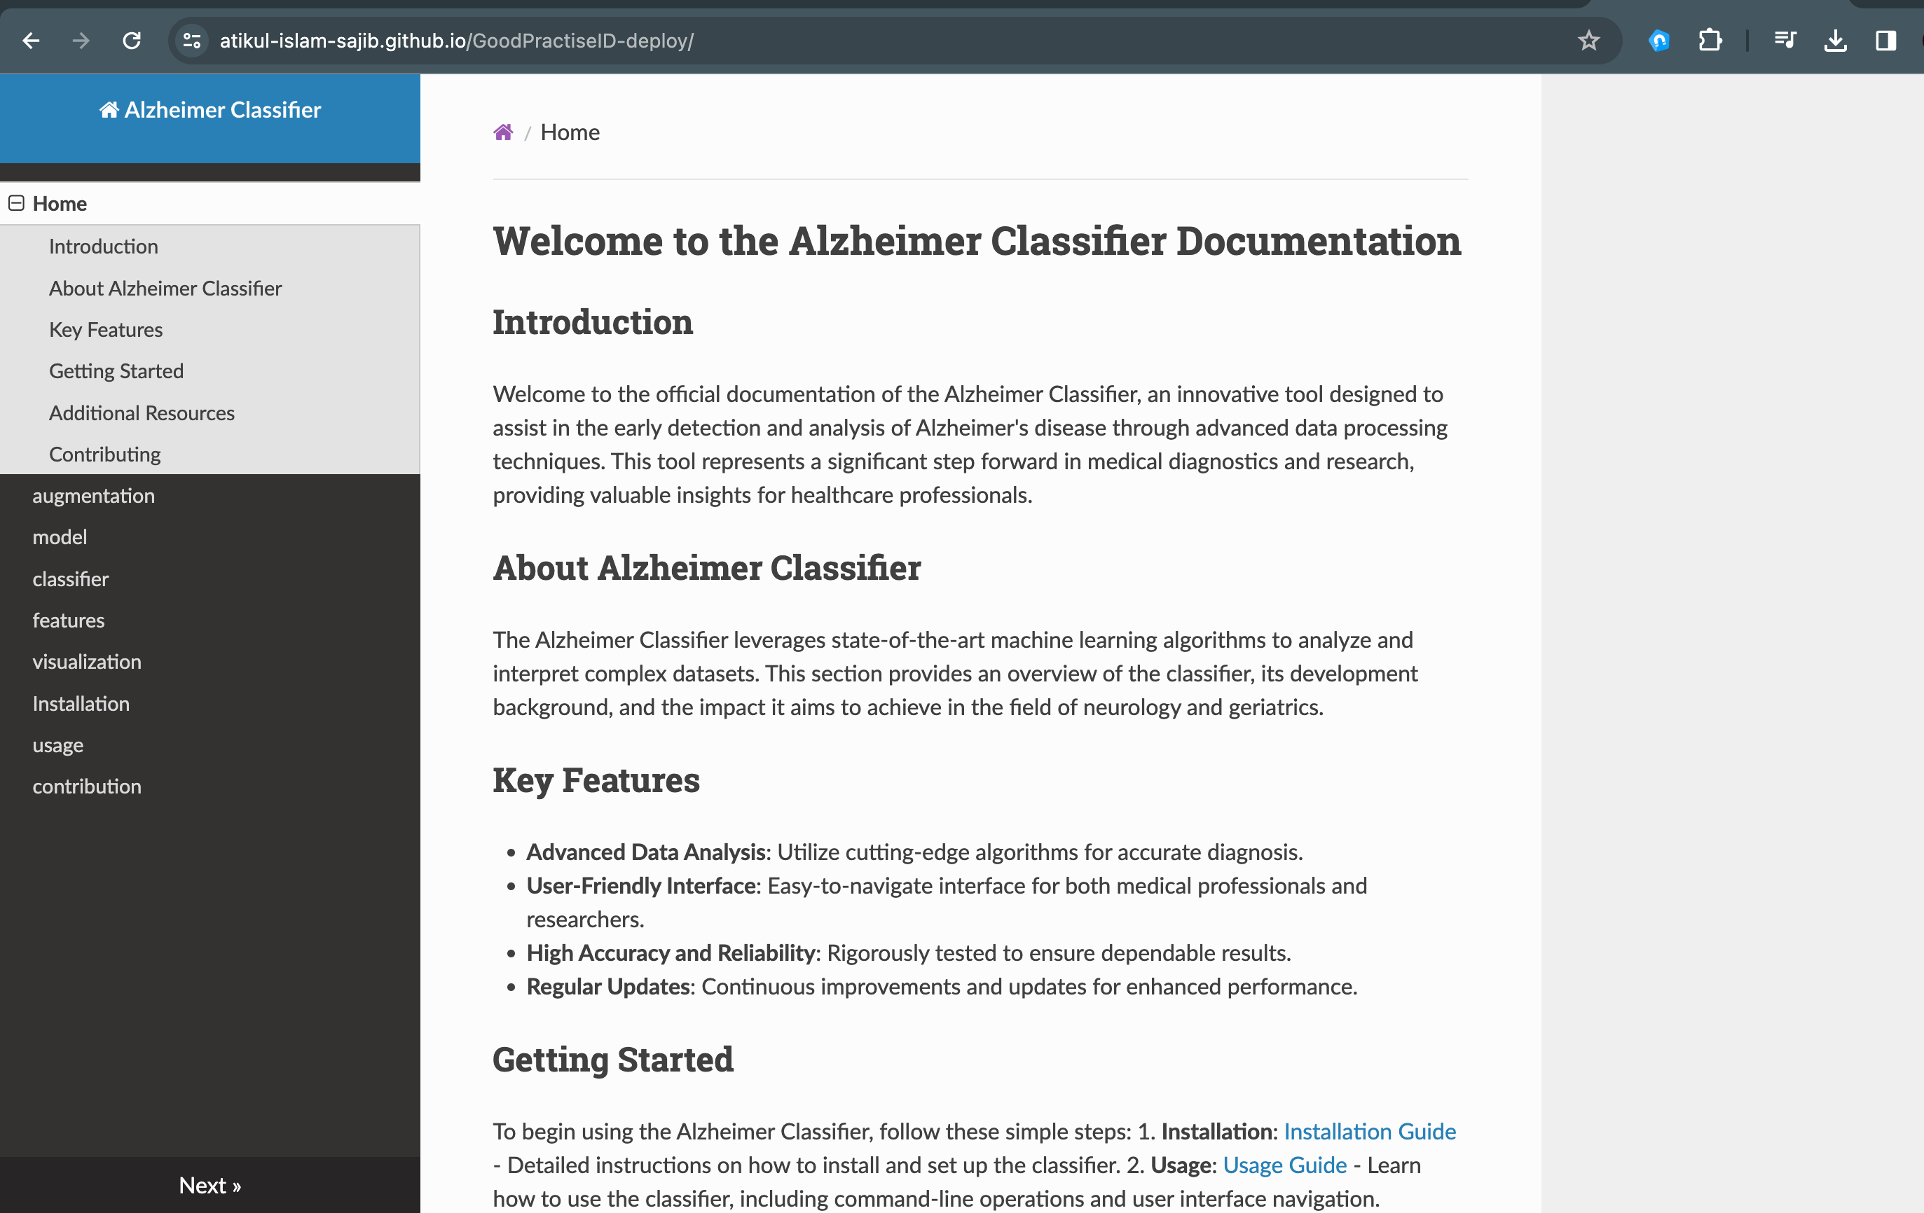
Documentation
Using mkdocs
docs link: https://atikul-islam-sajib.github.io/GoodPractiseID-deploy/

Slide 17
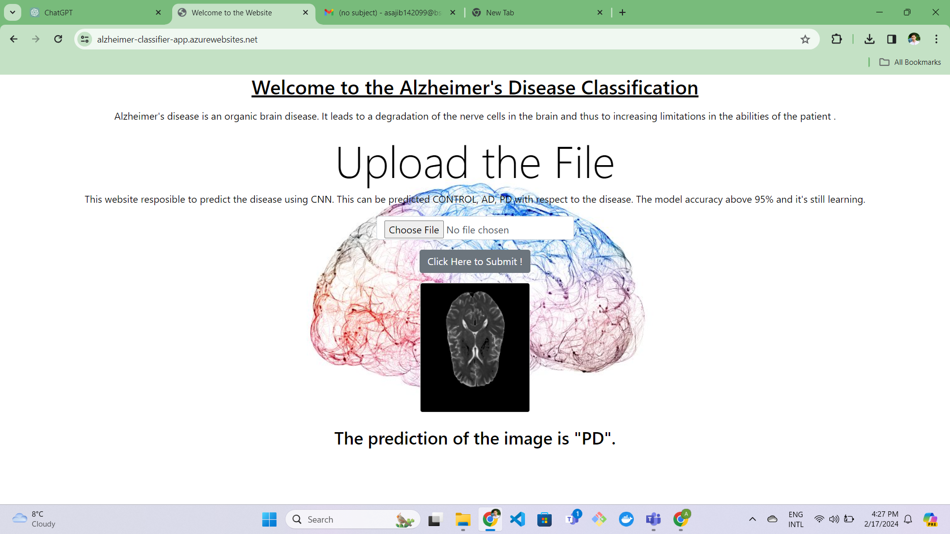
Final Outcome
Deploy this MODEL using FLASK and Microsoft Azure
Wesite link: https://alzheimer-classifier-app.azurewebsites.net/

Slide 18
LSGAN - Least Squared GAN: Alzheimer Dataset
Features
Utilizes PyTorch for implementing GAN models.
Provides scripts for easy training and generating synthetic images.
Command Line Interface for easy interaction.
Includes a custom data loader for the custom medical image dataset.
Customizable training parameters for experimenting with GAN.
Installation
git clone https://github.com/atikul-islam-sajib/LSGAN
cd LSGAN

Slide 19
LSGAN... ...
Install dependencies
pip install -r requirements.txt
Usage
python /path/to/LSGAN/src/cli.py --help

Slide 20
LSGAN... ...
Options
Option | Description
--batch_size | Set the batch size for the dataloader.
--image_path | Define the Custom dataset.
--epochs | Set the number of training epochs.
--latent_space | Define the size of the latent space for the model.
--lr | Specify the learning rate for training the model.
--num_samples | Determine the number of samples to generate after training.
--test | Run tests with synthetic data to validate model performance.
--device | Train the model with CPU, GPU, MPS.
--in_channels | Define the channels of the image (RGB=3/GRAY=1).

Slide 21
Training and Generating Images - CLI: CUDA
Training the GAN Model with CUDA
Process | Command | Parameters
Training the GAN Model with CUDA | python /content/LSGAN/clf.py --image_path "/path/to/dataset.zip" --batch_size 64 --image_size 64 --in_channels 3 --latent_space 100 --lr 0.0002 --epochs 10 --device cuda --folder | - image_path: Path to dataset - batch_size: 64 - image_size: 64 - in_channels: 3 - latent_space: 100 - lr: 0.0002 - epochs: 10 - device: cuda - folder: Clean directories before start
Generating Images with CUDA | python /content/LSGAN/clf.py --test --latent_space 100 --num_samples 20 --device cuda | -test: Indicates testing mode - latent_space: 100 - num_samples: 20 - device: cuda

Slide 22
Training and Generating Images - CLI: MPS
Training the GAN Model with MPS
Process | Command | Parameters
Training the GAN Model with MPS | python /content/LSGAN/clf.py --image_path "/path/to/dataset.zip" --batch_size 64 --image_size 64 --in_channels 3 --latent_space 100 --lr 0.0002 --epochs 10 --device mps --folder | - image_path: Path to dataset - batch_size: 64 - image_size: 64 - in_channels: 3 - latent_space: 100 - lr: 0.0002 - epochs: 10 - device: mps - folder: Clean directories before start
Generating Images with MPS | python /content/LSGAN/clf.py --test --latent_space 100 --num_samples 20 --device mps | -test: Indicates testing mode - latent_space: 100 - num_samples: 20 - device: mps

Slide 23
Training and Generating Images - CLI: CPU
Training the GAN Model with CPU
Process | Command | Parameters
Training the GAN Model with CPU | python /content/LSGAN/clf.py --image_path "/path/to/dataset.zip" --batch_size 64 --image_size 64 --in_channels 3 --latent_space 100 --lr 0.0002 --epochs 10 --device cpu --folder | - image_path: Path to dataset - batch_size: 64 - image_size: 64 - in_channels: 3 - latent_space: 100 - lr: 0.0002 - epochs: 10 - device: cpu - folder: Clean directories before start
Generating Images with CPU | python /content/LSGAN/clf.py --test --latent_space 100 --num_samples 20 --device cpu | -test: Indicates testing mode - latent_space: 100 - num_samples: 20 - device: cpu

Slide 24
Training and Generating - Importing Modules: CUDA
from src.dataloader import Loader
from src.discriminator import Discriminator
from src.generator import Generator
from src.trainer import Trainer
from src.test import Test
loader = Loader(
image_path="./alzheimer.zip",batch_size=128,image_size=64)
loader.unzip_folder()
loader.create_dataloader()
trainer = Trainer(
image_size=64,input_channels=3,latent_space=100,lr=0.0002,epochs=100,device="cuda")
trainer.train()
test = Test(
latent_space=100, num_samples=20, device="cuda")
test.test()

Slide 25
Training and Generating - Importing Modules: MPS
from src.dataloader import Loader
from src.discriminator import Discriminator
from src.generator import Generator
from src.trainer import Trainer
from src.test import Test
loader = Loader(
image_path="./alzheimer.zip",batch_size=128,image_size=64)
loader.unzip_folder()
loader.create_dataloader()
trainer = Trainer(
image_size=64,input_channels=3,latent_space=100,lr=0.0002,epochs=100,device="mps")
trainer.train()
test = Test(
latent_space=100, num_samples=20, device="mps")
test.test()

Slide 26
Training and Generating - Importing Modules: CPU
from src.dataloader import Loader
from src.discriminator import Discriminator
from src.generator import Generator
from src.trainer import Trainer
from src.test import Test
loader = Loader(
image_path="./alzheimer.zip",batch_size=128,image_size=64)
loader.unzip_folder()
loader.create_dataloader()
trainer = Trainer(
image_size=64,input_channels=3,latent_space=100,lr=0.0002,epochs=100,device="cpu")
trainer.train()
test = Test(
latent_space=100, num_samples=20, device="cpu")
test.test()

Slide 27
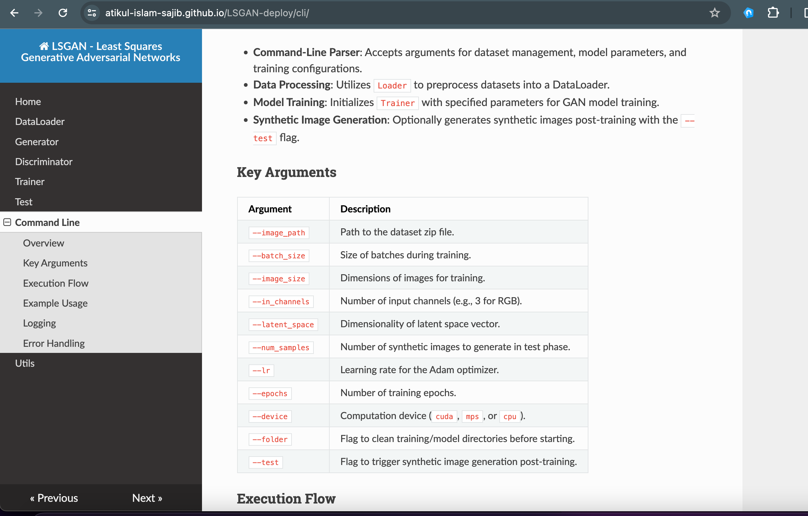
Documentation: LSGAN
Using mkdocs
Docs link: https://atikul-islam-sajib.github.io/LSGAN-deploy/

Slide 28
References
Alzheimer Project Github link:
https://github.com/atikul-islam-sajib/GoodPractiseDSID
Alzheimer Project documentation link:
https://atikul-islam-sajib.github.io/GoodPractiseID-deploy/
Website link
https://alzheimer-classifier-app.azurewebsites.net/
LSGAN Github link:
https://github.com/atikul-islam-sajib/LSGAN
LSGAN Documentation link:
https://atikul-islam-sajib.github.io/LSGAN-deploy/

Slide 29
Thank you!

